Slide 1
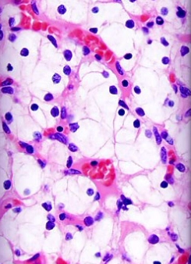
Breast Cancer Biopsy Data
Amy Femal

Slide 2
The Dataset
The biopsy dataset includes 569 observations collected by the University of Wisconsin in 1992 from fine needle aspiration biopsies on masses found in breast tissue. During this procedure, a hallow needle attached to a syringe is used to withdraw tissue or fluid from the mass. The variables in the dataset describe the cell nuclei obtained during the biopsies and the diagnosis.

Slide 3
Statistical Questions
What variables are significant to the diagnosis of breast cancer?
Using these significant variables, can I use machine learning to predict diagnosis with high accuracy?

Slide 4
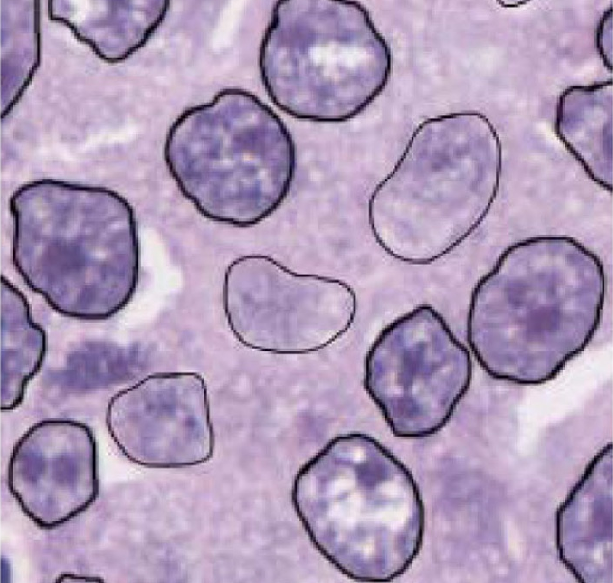
Variables in the Dataset
radius - the mean of distances from the center of the cell nuclei to points on the perimeter
texture - the mean texture of the nuclei, described by the spatial arrangement and variation of grey values observed
perimeter - the mean distance around the nuclei
area - the mean area of the nuclei
smoothness - the mean of local variation in radius lengths
diagnosis - the diagnosis of the mass, where 0 = malignant and 1 = benign.

Slide 5
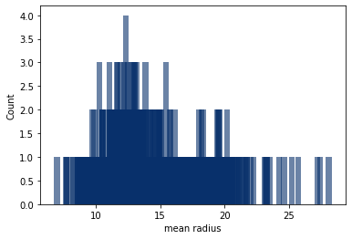
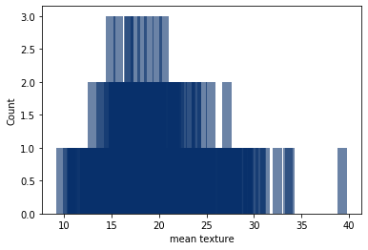
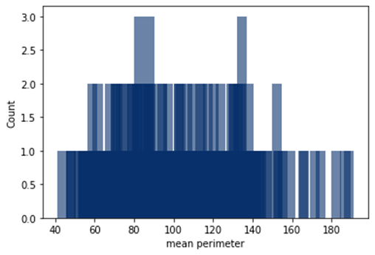
Variable Distribution
radius
texture
perimeter
mean 14.13
mode 12.34
std 3.52
min 6.98
25% 11.70
50% 13.37
75% 15.78
max 28.11
mean 19.29
mode multimodal
std 4.30
min 9.71
25% 16.17
50% 18.84
75% 21.80
max 39.28
mean 91.97
mode multimodal
std 24.30
min 43.79
25% 75.17
50% 86.24
75% 104.10
max 188.50

Slide 6
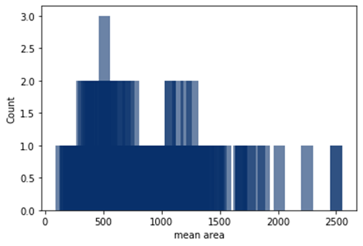
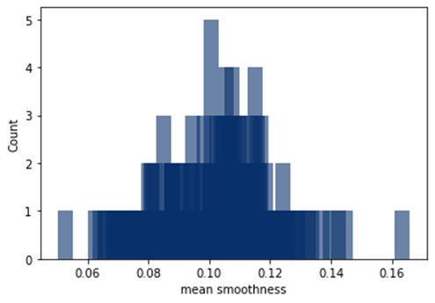
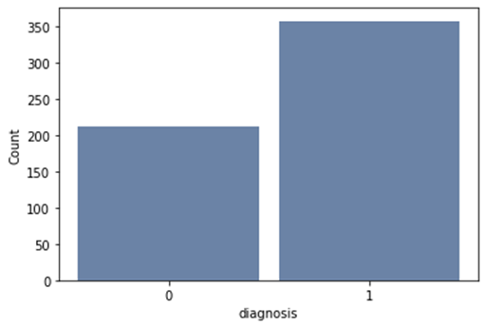
Variable Distribution
area
smoothness
diagnosis
mean 654.89
mode 512.20
std 351.91
min 142.50
25% 420.30
50% 551.10
75% 782.70
max 2501.00
mean 0.096
mode 0.101
std 0.014
min 0.053
25% 0.086
50% 0.096
75% 0.105
max 0.163
mean 0.627
mode 1
std 0.484
min 0
25% 0
50% 1
75% 1
max 1

Slide 7
Variable Distribution
All variables, except diagnosis, have right-skewed distributions. Though many outliers are evident, they do not appear to be errors within the data. Therefore, I will use all observations in my analysis as they have been recorded.

Slide 8
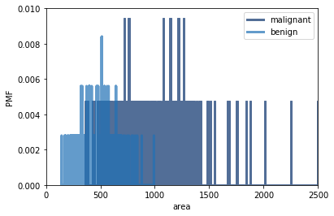
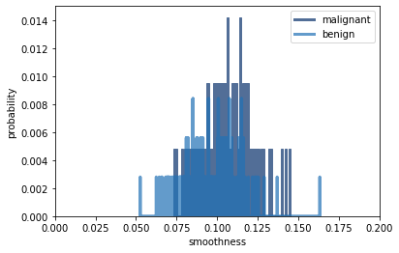
Diagnosis – Malignant vs Benign
I have divided the data between the two diagnosis groups, malignant and benign. The PMFs of area and smoothness for malignant and benign diagnosis indicate cell nuclei with larger areas and smoothness are more likely to be malignant.

Slide 9
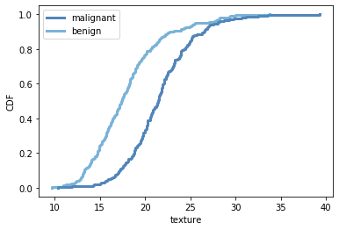
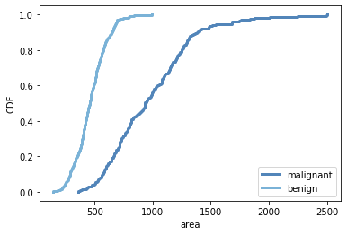
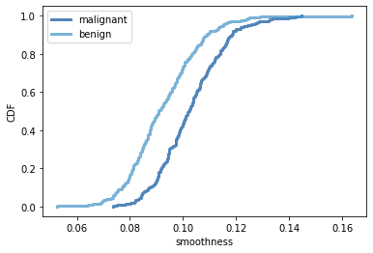
Comparing CDFs
The CDFs show texture, area, and smoothness are significantly larger throughout the distribution for malignant diagnosis.

Slide 10
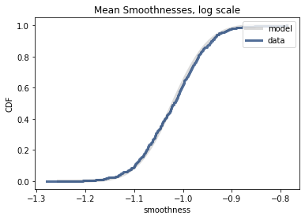
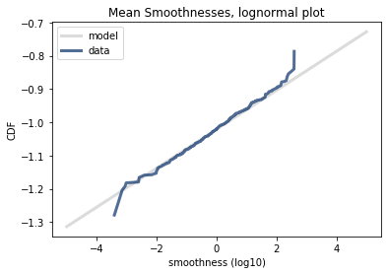
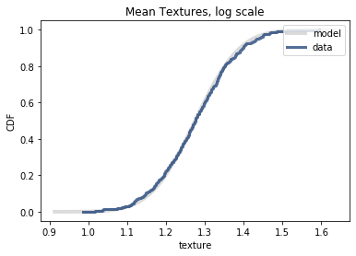
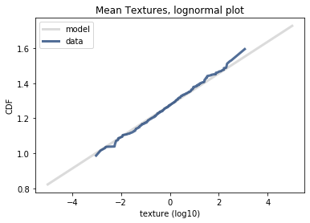
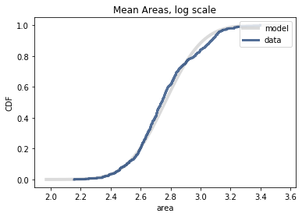
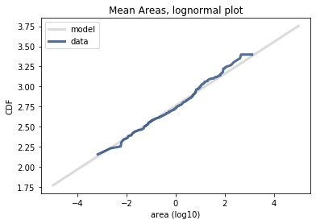
Lognormal Distribution
The CDFs of texture, area, and smoothness have the shape of a lognormal distribution. The lognormal model fits the data very well.

Slide 11
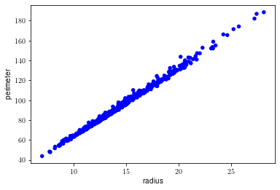
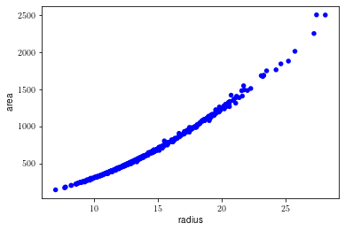
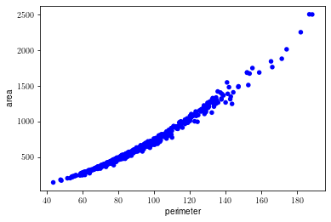
Scatter Plots Correlation vs Causation
Correlation 0.99786
Correlation 0.98738
Correlation 0.98651
Like expected, perimeter, radius, and area of cell nuclei are highly correlated. Considering the geometry of a circle, the perimeter (circumference) is $2πr$and the area is${πr}^{2}$. Therefore, I conclude that radius is causally correlated with perimeter and area.

Slide 12
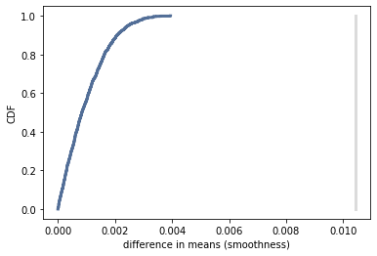
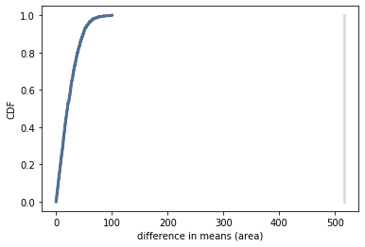
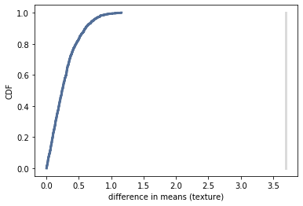
Hypothesis Test
Permutation hypothesis tests on texture, area, and smoothness yield p-values of 0. These results confirm the difference in means of texture, area, and smoothness between malignant and benign diagnosis are statistically significant. The plots below show that the CDFs never intersect the observed differences.

Slide 13
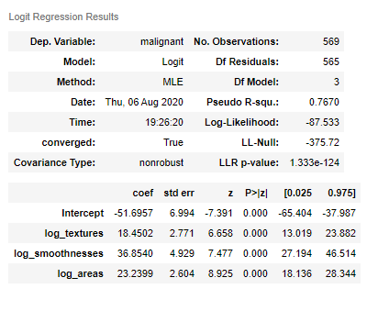
Logistic Regression
Based on the high correlation of radius, perimeter, and area, I have decided to remove radius and perimeter from the model. As the data follows a lognormal distribution, I have used the log transformation of texture, area, and smoothness in a logistic regression model to predict diagnosis with 94% accuracy.

Slide 14
References
Fine Needle Aspiration (FNA) Biopsy of the Breast: Breast Aspiration. (n.d.). Retrieved August 06, 2020, from https://www.cancer.org/cancer/breast-cancer/screening-tests-and-early-detection/breast-biopsy/fine-needle-aspiration-biopsy-of-the-breast.html
Singh Suwal, M. (2018, September 26) Breast Cancer Prediction Dataset. Retrieved July 07, 2020 from, www.kaggle.com/merishnasuwal/breast-cancer-prediction-dataset

